Slide 1






credit card
Home
About Us
Service
Get in Touch
Exploring card usage in credit card dataset
BY:-
K.Ulaganathan

Slide 2


credit card
Home
About Us
Service
Get in Touch
WHAT ?
The dataset contains customer credit card usage details, with both numeric and categorical features.
1. Customer Demographics & Card Information
Card Type → Silver, Gold, Platinum, etc.
Possibly Gender, Region, or Age group
2.Financial Attributes (Numeric Features)
Income→ Annual income of the customer.
Expenditure → Total spending made using the card.
Balance → Outstanding balance on the card.
Purchases → Amount spent on purchases (sometimes split into one-off vs. installment purchases)
.
Payments → Payments made towards the credit card balance.
Cash Advance → Amount withdrawn as cash using the credit card.
Next Slide

Slide 3
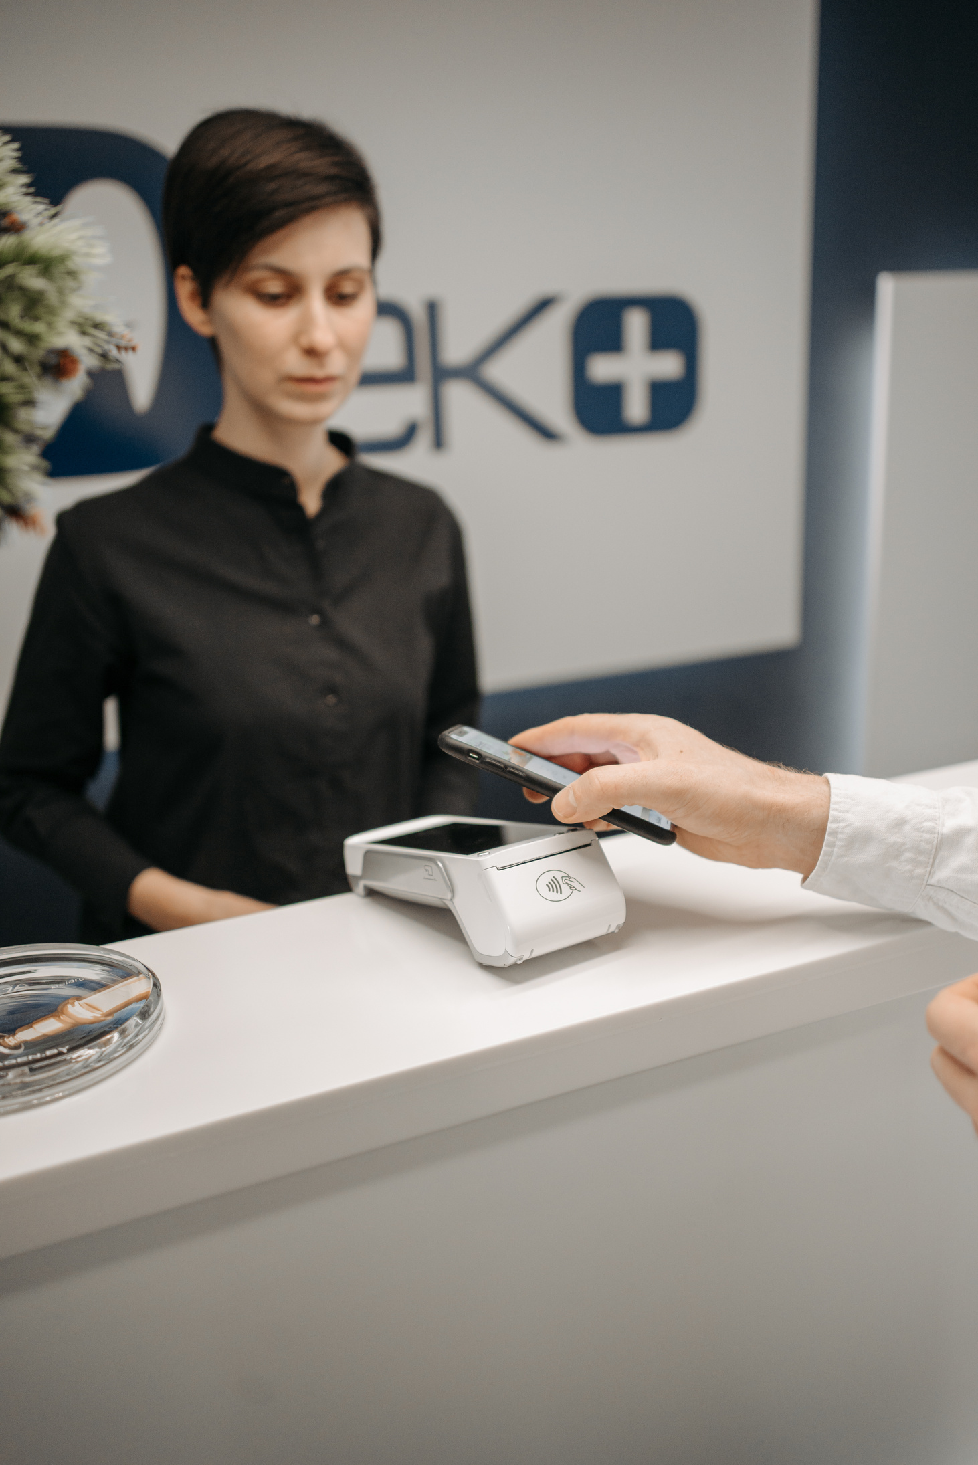
credit card
Home
About Us
Service
Get in Touch
WHAT we analyze ?
We analyze customer profiles, income levels, expenditure, purchases, cash
advances, balances, and card types, along with their relationships and patterns.
This helps in customer segmentation, risk assessment, and business strategy.
What We Show ?
We show customer distributions, spending habits, card type preferences,
cash advance usage, outliers, and correlations through a mix of boxplots,
histograms, bar charts, count plots, and heatmaps.
Next Slide

Slide 4

credit card
Home
About Us
Service
Get in Touch
Introduction
This project focuses on analyzing customer credit card data to gain insights into spending behavior,
income distribution, card preferences, and overall financial activity.
By leveraging data visualization and statistical techniques, the study highlights key patterns such as customer segmentation,
usage trends, and correlations between financial features.
Understanding these patterns is crucial for businesses to improve customer, satisfaction
design personalized offers, and optimize financial products.

Slide 5

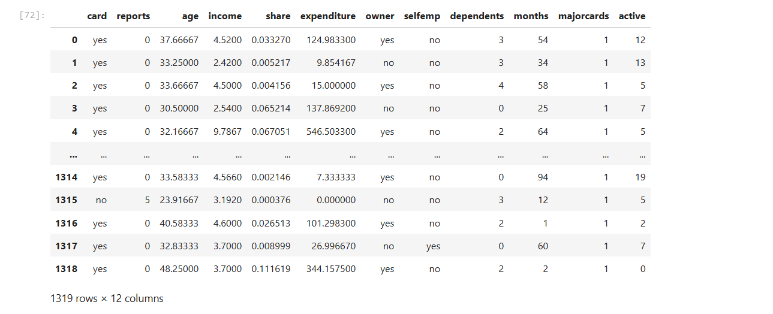
credit card
Home
About Us
Service
Get in Touch
Dataset overview

Slide 6

credit card
Home
About Us
Service
Get in Touch
Data cleaning
Missing values
Outlier Detection
Checked for null/missing entries across all columns.
Either filled them with mean/median
(for numeric) or mode (for categorical), or removed rows if the missing data was small and not meaningful.
Used boxplots to identify extreme values in numeric columns (e.g., income, expenditure).
used boxplots and IQR method to detect extreme outliers .
Removing Duplicates
Overall
Verified if duplicate rows exist in the dataset.
Removed duplicates to avoid double-counting the same customer.
The project’s data cleaning involved handling missing values, removing duplicates, checking outliers,
correcting data types, dealing with skewness, scaling numeric features, and verifying correlations.

Slide 7
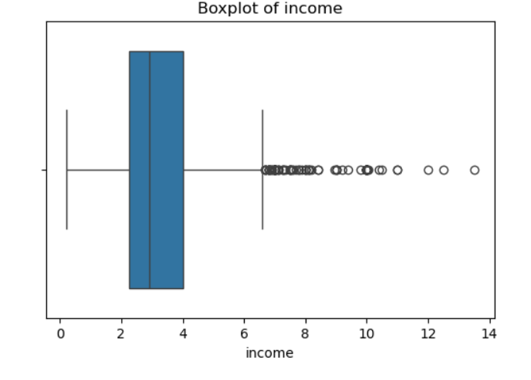
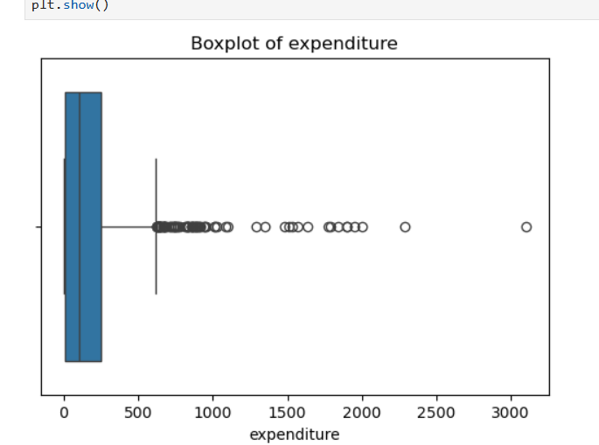
credit card
Home
About Us
Service
Get in Touch
Exploratory data Analysis (EDA)
Univarient

Slide 8
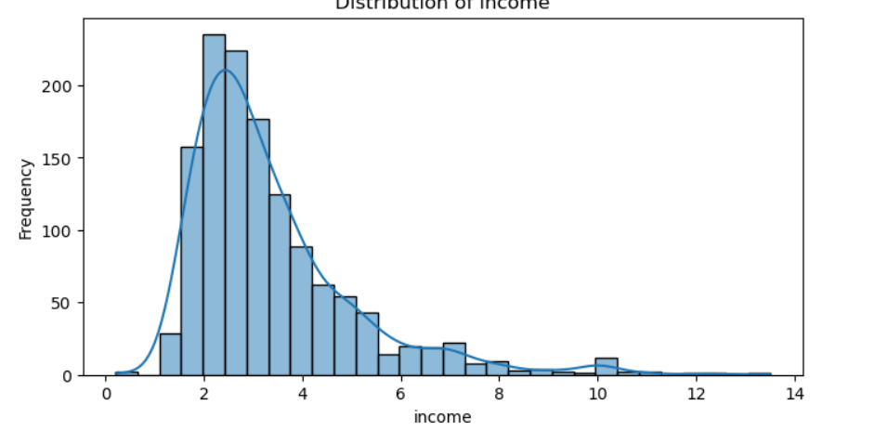
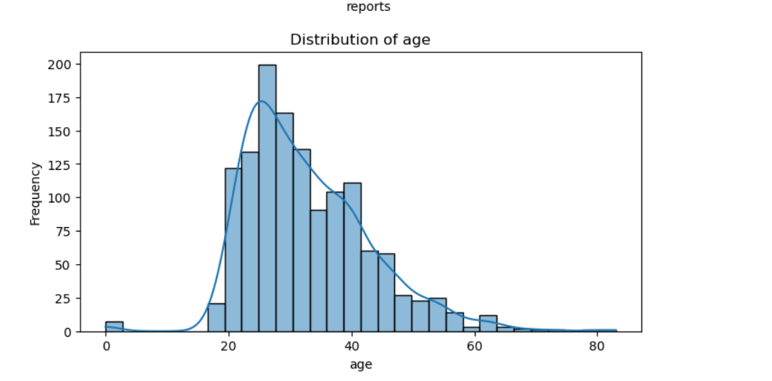
credit card
Home
About Us
Service
Get in Touch
Histogram for income
Histogram for age

Slide 9
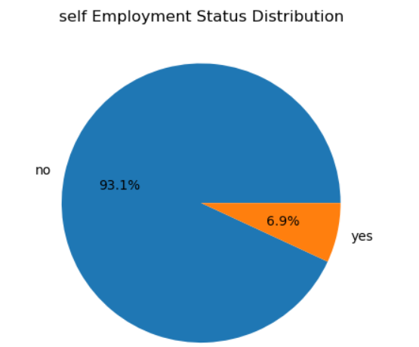
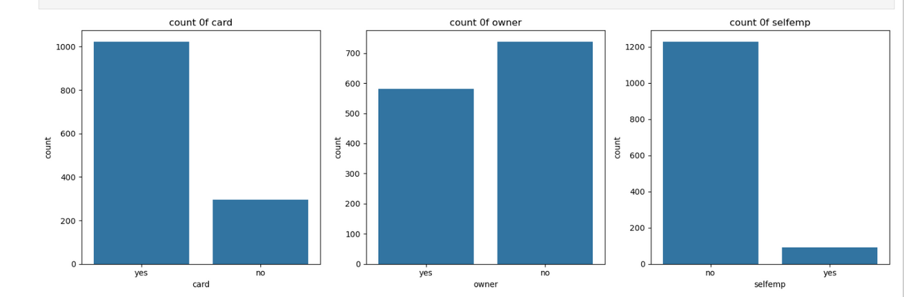
credit card
Home
About Us
Service
Get in Touch
count plot for card, owner, selfemp

Slide 10
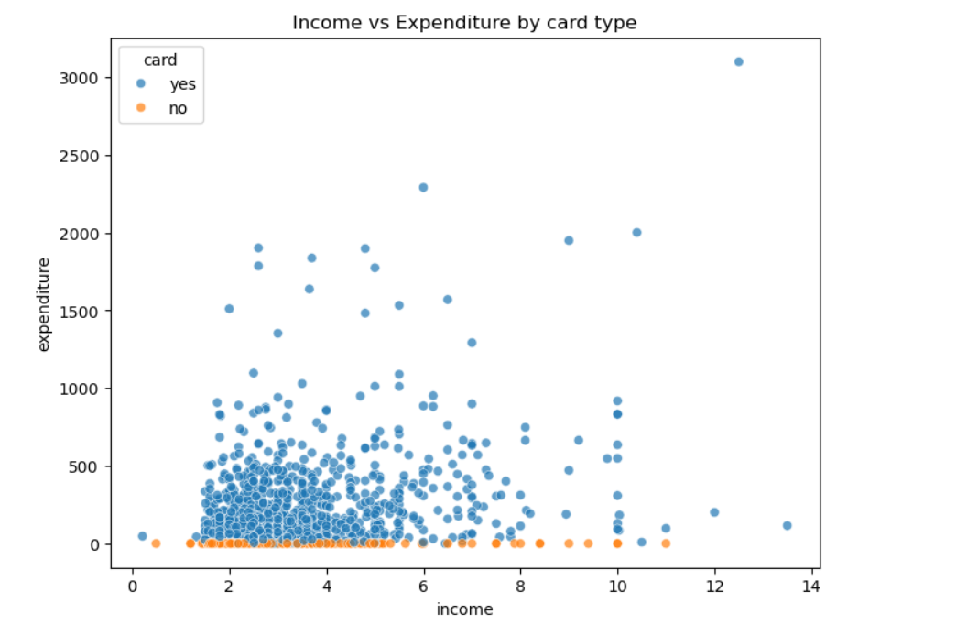
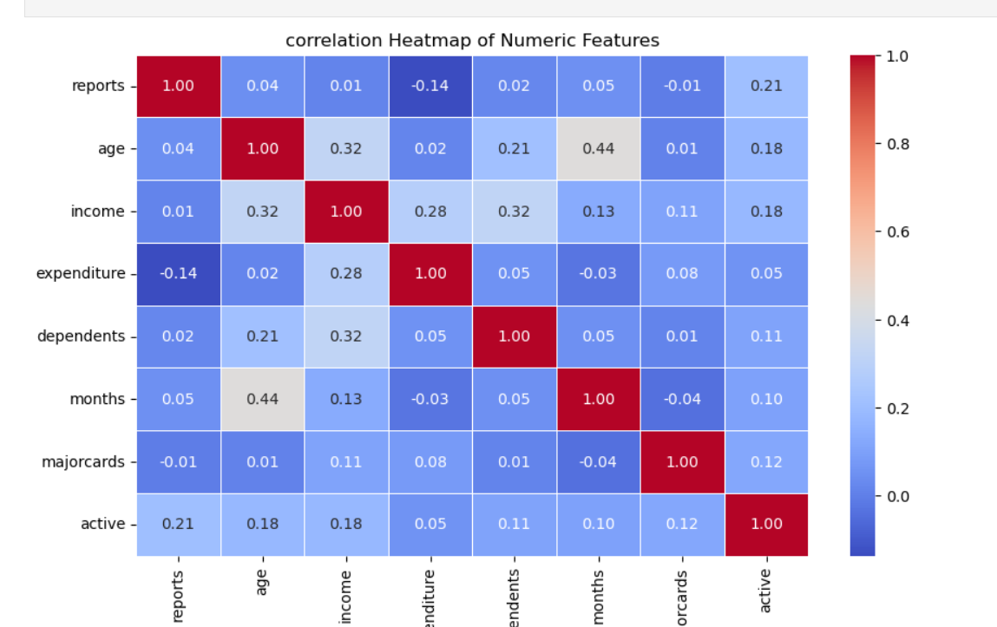
Bivarient analysis
Multi varient analysis

Slide 11
Thank You
reallygreatsite.com
+123-456-7890

